Slide 1
Easterseals Crossroads INDATA Project Overview

Slide 2
Easterseals Crossroads
Emphasizing Ability for the past 80 years. As we help individuals with disabilities and special needs live better lives by promoting inclusion, independence and dignity.
General Information
Who we serve?
Geography
- Easterseals Agency
- United Way Agency
- CARF Accredited
- INDATA
All inclusive
Mobility
Intellectual Cognitive
Blind or Low Vision
Sensory
Developmental
- Central Indiana
- AT - Statewide

Slide 3
Easterseals Crossroads Services
Children’s Medical
Autism Services
Community Day Supports
Speech Therapy
Physical Therapy
Occupational Therapy
Enrichment Programs – Camps
First Steps
Diagnostic Clinic
Behavioral Services
Family Resource Center
Adult Day
Customized Life Skills
Recreational Therapy
Respite Services
Deaf and HoH Services
Employment Services
Veteran Services
ASL Interpreters
Case Management
Hear Indiana
Employment Services
Project Search
Benefit Analysis
Transition Services
Employment Services
Rally Point Events
Community Events

Slide 4
Assistive Technology Services
INDATA – Indiana Assistive Technology Act Program
Clinical Assistive Technology
Home Modification
Digital Literacy
Web/Document Accessibility
Augmentative Communication
Notes:
Take away – I don’t work in isolation – part of a multi-disciplinary team – I recognize I don’t have all the answers but I’m surrounded by others with a lot of different educational and experiential backgrounds that help me serve people better

Slide 5
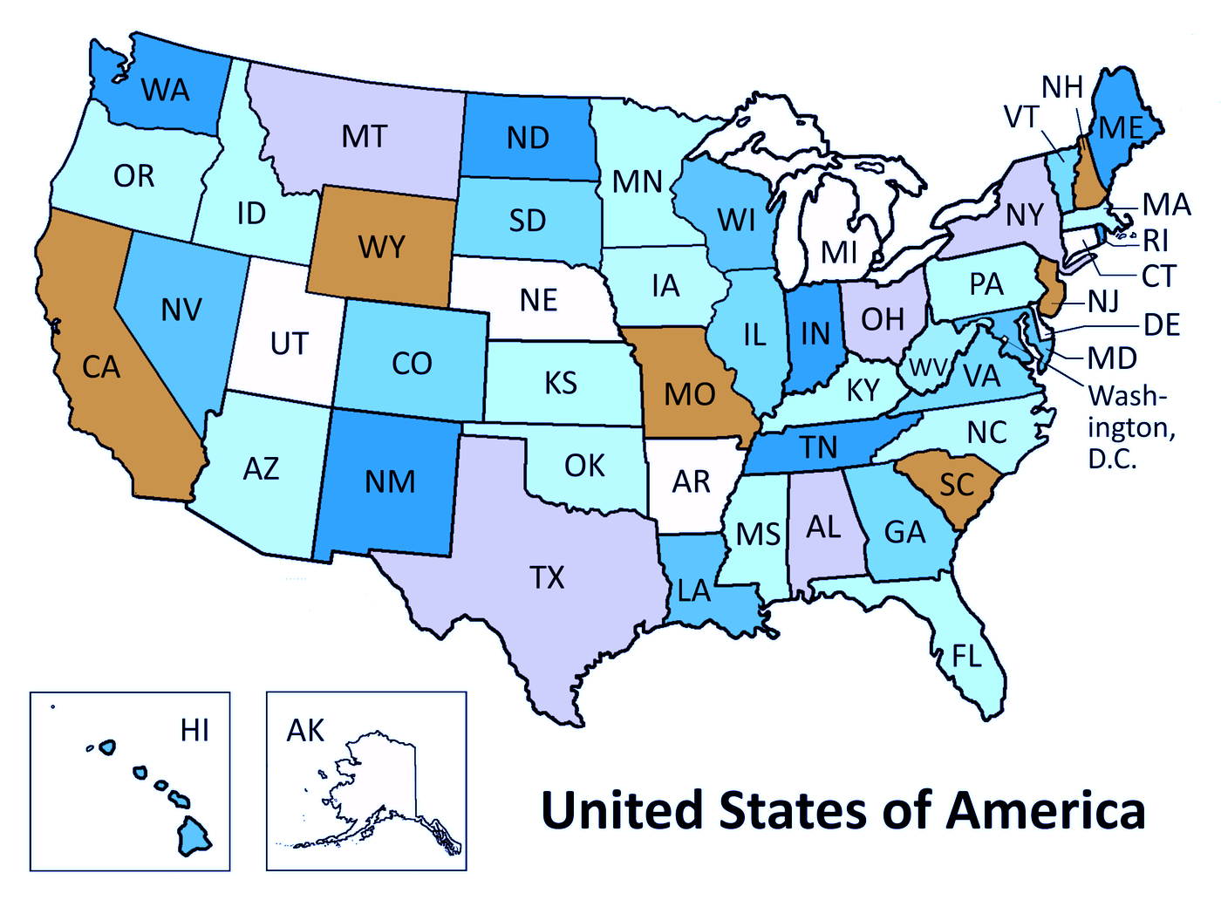
INDATA (Indiana Assistive Technology Act Program)
State AT Programs
56 programs – every state and Territory
2 Primary Goals
Spread the Word! Get Your Hands On it!
This Photo by Unknown Author is licensed under CC BY-SA

Slide 6
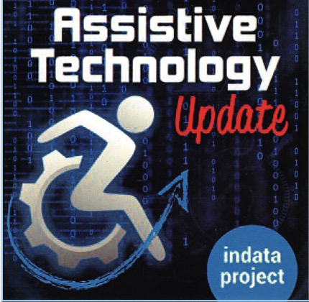
Outreach and Information
Information and Assistance
888-466-1214
Tech@eastersealscrossroads.org
AT Hours
One hour (or so) talks with hands-on AT experience
Full Day Training
4 times /year with streaming
Guest Lectures
Indiana Colleges and Universities
Podcasts
ATUpdate
Accessibility Minute
ATFAQ
Social Media
Blog, YouTube, Facebook, Twitter, Others
www.eastersealstech.com

Slide 7
Demonstration and Loan To your door demonstrations of various assistive devices
Demos
20-30 minute “test drives”
No recommendations
Lending Library
2500+ items
30-day Loans
Indiana only
Library Purpose:
Assist in decision making
Serve as a loaner during device repair or while waiting on AT funding
Provide a short-term accommodation
Devices for persons with visual, cognitive, hearing, mobility, learning or other needs
www.eastersealstech.com/library

Slide 8
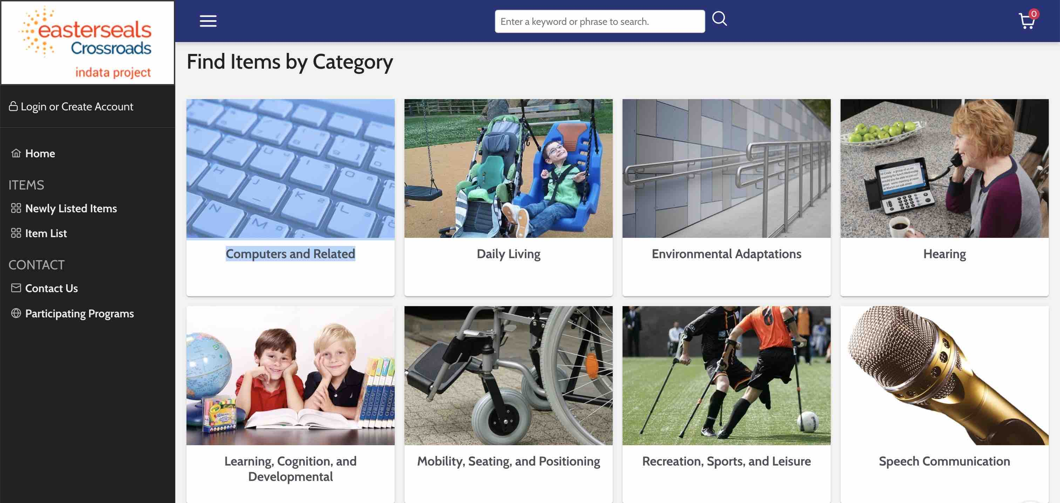
Online Loan Library
Intuitive Interface to help you find the equipment you are looking for
Search by
- Keyword
- Category
Bookmark items
Request Loans
www.indata.at4all.com

Slide 9
Alternative Financing Program
Available through a partnership between Easterseals Crossroads and STAR Financial
What can it be used for?
Adaptive vehicles
Vehicle Modifications
Aug. comm. devices
Braille equipment
Computers
Hearing aids
Home modifications
And much, much more!
Who Qualifies?
Indiana residents
Documented disability
How do I get started?
Easy as 1, 2, 3!
Call us at 888-466-1314 with documentation of a disability.
Complete an AFP loan application.
If approved, complete a loan agreement with Star Financial and arrange payments.
www.eastersealstech.com/financing

Slide 10
The INDATA Depot Computer and Assistive Technology Recycling Program
Assistive Technology Recycling
Video magnifiers and other AT devices
Equipment is sanitized and repaired
Available to Indiana residents
Computer Recycling
Accept donated computers
Wiped of all previous data and refurbished
Install Win 10 and MS Office
Who qualifies?
Resident of Indiana
Document of Disability
www.eastersealstech.com/depot

Slide 11
Resource Hub
www.eastersealstech.com
Podcasts
TechTips
Blog
PDF Downloads
AT Funding Guide
AT Champion Award
Etc.

Slide 12
INDATA Overview
12

Slide 13
Summary If you have questions, we have answers.
888-466-1314
INDATA at Easterseals Crossroads
4740 Kingsway Drive
Indianapolis, IN 46205
tech@eastersealscrossroads.org
www.EasterSealsTech.com
13
Notes:
Changes in perception and motor control may make it harder to see a computer screen, type on a keyboard or use a mouse
23% of rural customers acknowledge that access to high-speed internet is a major problem for their community.
15% do not have any type of internet or are not sure if they have it.

Slide 14
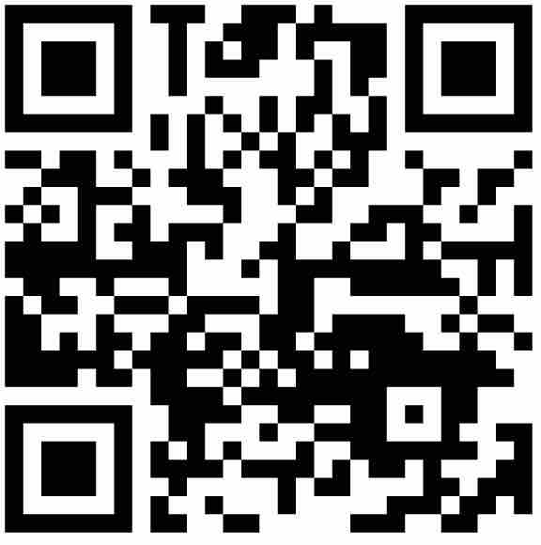
Thank You for Joining us Today!
Please take a moment to fill out the survey that launches in your browser after the training.
Training Material QR Code
Training Material Web Link:
eastersealstech.com/2023autismconference
14

